Slide 1
American College of Physicians Fostering Excellence & Professionalism in Internal Medicine 2018
Dr. Quazi Tarikul Islam, ACP Ambassador

Slide 2
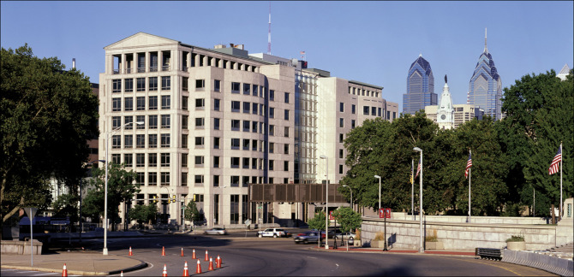
The American College of Physicians (Founded in 1915)
Philadelphia, PA
Washington, DC

Slide 3
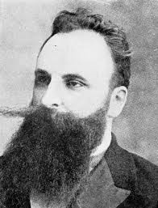
ACP’s Founder
1913 – participates in the Royal College of Physicians in London
1914 – together with six colleagues convenes the American Congress on Internal Medicine to “facilitate scientific exchange among doctors interested in internal medicine”
1915 – incorporation of the American College of Physicians
Heinrich Stern, MD 1867-1918

Slide 4
Who We Are
Internists apply scientific knowledge and clinical expertise to the diagnosis, treatment, and compassionate care of adults across the spectrum from health to complex illness.
The ACP community includes internists, internal medicine subspecialists, residents and fellows in training, and medical students.

Slide 5
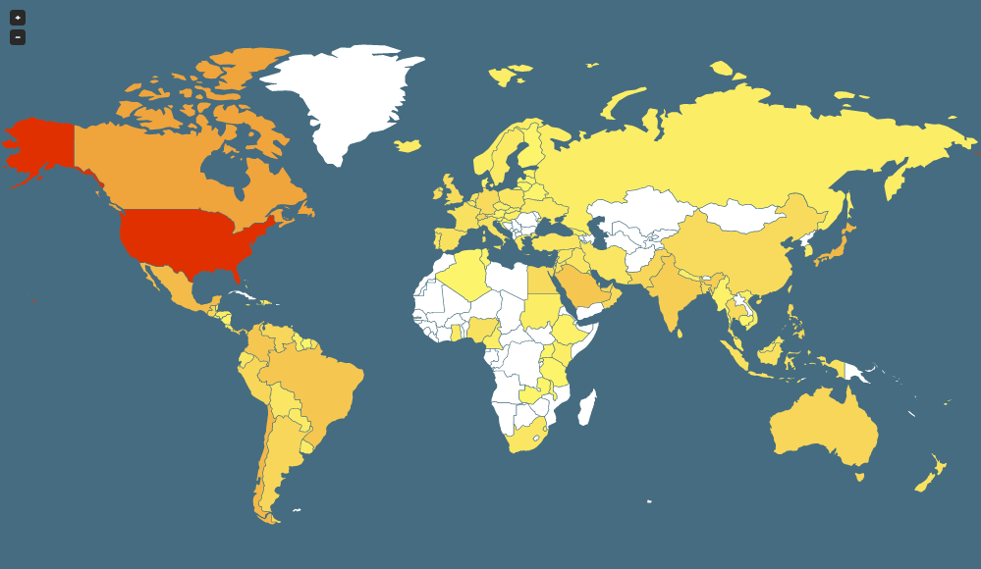
ACP is a Global Community
154,000 members (over 10% live outside of the United States)
International chapters: Bangladesh, Brazil, Caribbean, Canada (6), Central America, Chile, Colombia, India, Japan, Mexico, Saudi Arabia, Southeast Asian, and Venezuela
Collaborations with several Internal Medicine Societies outside the US

Slide 6
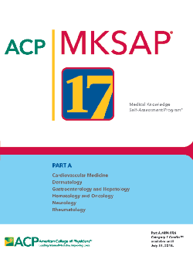
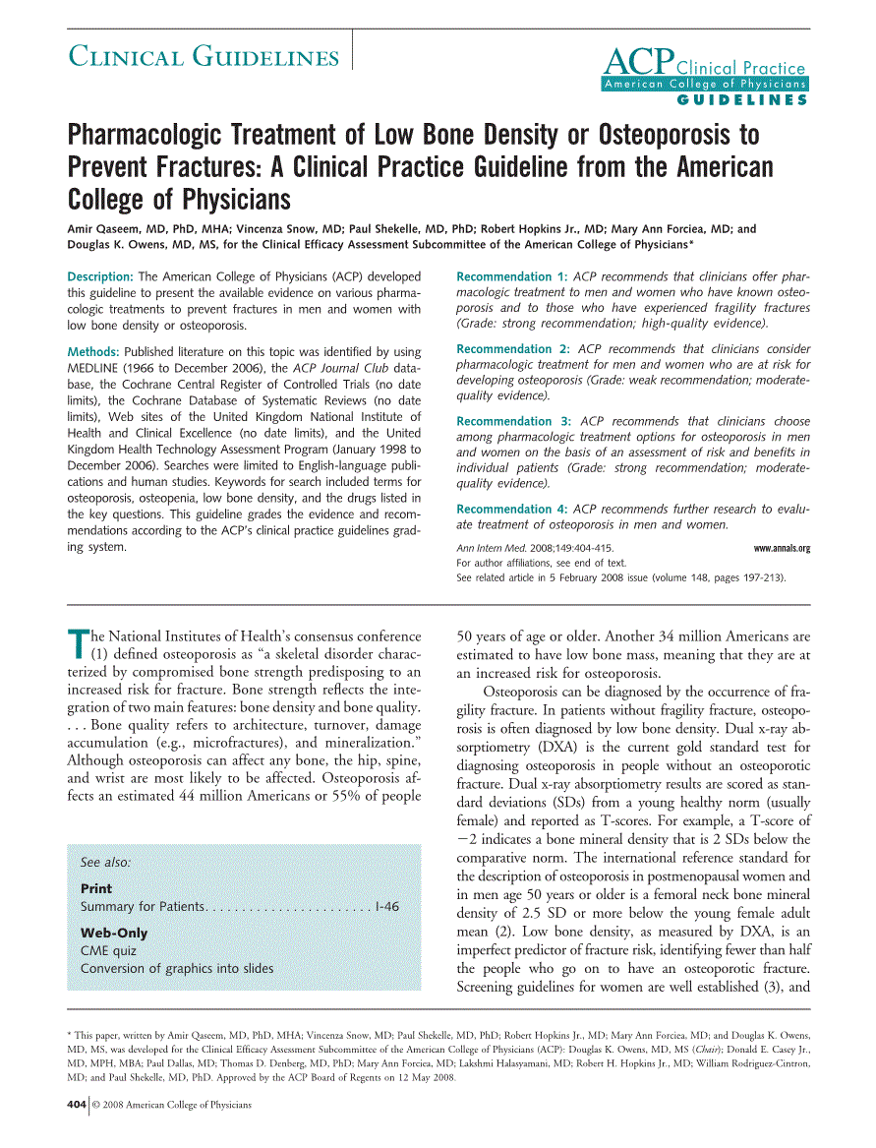
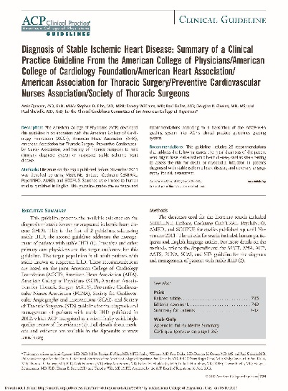
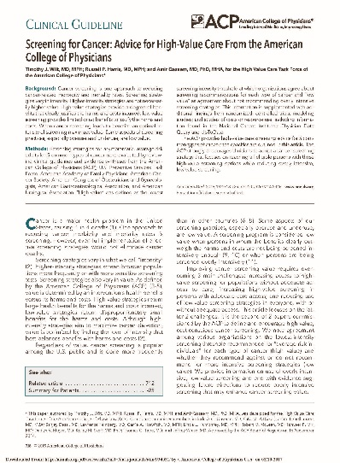
What We Do
Offer innovative education
Promote the highest clinical standards
Support our members and their patients

Slide 7
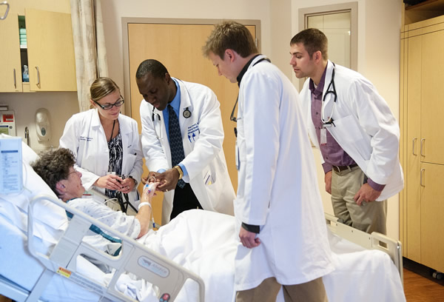
What We Do
Defend positions on individual health, and serve as the “conscience” of medicine
Promote internal medicine as a career

Slide 8
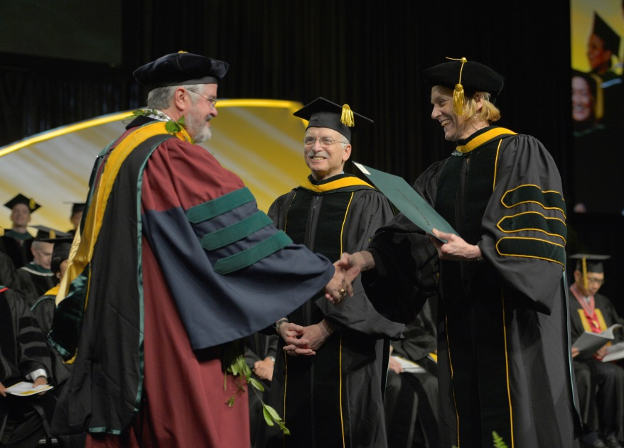
What We Do
ACP Fellowship
Fellowship in the College is an honor. Being an FACP® is a distinction earned from colleagues who recognize your accomplishments and achievements in the practice of internal medicine
Recognize excellence and distinguished contributions to internal medicine
www.acponline.org/FACP

Slide 9
Resources for Patients
Patient education materials
Patient-oriented educational resources for over 25 clinical conditions, instructional videos, and other useful resources for use with patients
Patient care tools
Resources for managing ethical and professionalism issues, tools for dealing with end-of-life decision making, and other information helpful in maintaining and enhancing the doctor-patient relationship

Slide 10
Community
International newsletter
International Council
Representing the international community to ACP governance
International Fellowship Exchange Program
Provides opportunities for international members to undertake focused study in the US
Ambassadors Program
Sends ACP leaders to engage with ACP chapters, other medical societies, and members outside the US
International educational programs
Member Online Forums

Slide 11
ACP Internal Medicine Meeting April 11-13, 2019 – Philadelphia, PA
Register and enjoy:
A variety of unique learning formats and Clinical Skills Activities to provide a well-rounded educational experience
Updates in internal medicine and the subspecialties
Hands-on Training and Workshops to refresh your clinical skills
Networking opportunities, receptions, and a variety of special events
Discounted International Group Registrations rates available

Slide 12
ACP International Programs
For general questions, please contact the ACP International Programs Office at internationaloffice@acponline.org
Thank you!
Follow ACP on social media

